Slide 1
Computer Science Ethics
15-110

Slide 2
Learning Goals
Critically reflect on individual ethical concerns in relation to Computer Science
Highlight examples of ethics-related instances in the real world
Understand the significance of ethics from the perspective of your own academic disciplines and desired careers
Engage in discussions of ethical questions with peers

Slide 3
Ethics in Computer Science
When we move from theoretical concepts of computer science to applying those theories in real life, the decisions we make have consequences.
These consequences can be a direct result of the technology itself or can have an indirect social impact that the technology may facilitate. As responsible designers and developers of technology, it is important to consider both cases.
Today, we will cover some topics in computing that highlight how data, machine learning, and AI algorithms can impact individuals both directly and indirectly.

Slide 4
Ethics in Computer Science
The professional field of computer science has only recently adopted a code of ethics, and the code is not yet uniformly taught to new computer scientists or programmers. There is still much to debate over what the responsibilities of computer scientists are.
As its primary ethical principle, the code of ethics states that computing professionals should contribute to society and to human well-being, acknowledging that all people are stakeholders in computing.
When reflecting on ethical responsibilities, it may be helpful to ask yourself: “What should we value broadly as a society? And what should we do to realize those values?”

Slide 5
Data

Slide 6
Collecting User Data
Most applications collect data about users from various sources. As a user of the internet and various applications, you already voluntarily share a lot of data with the world!
Internet – profile information, tweets, searches
Applications – preferences, locations, images
Real life – purchase history, contact info, location
Behind the scenes, your browser or phone/computer is sending additional information to the services you use. Check out the data your browser shares here: https://webkay.robinlinus.com/

Slide 7
Data Economy
Why are so many companies interested in data collection? Data has become the economy of the internet. Most websites are supported by advertising, and advertisers pay more for targeted ads.
Even companies that don’t rely on advertising have a use for user data – they can sell data to other companies. This data is aggregated by companies that can then sell portfolios of individuals to advertisers or insurance companies.
Even when companies promise not to sell individual data, it still isn't entirely private. For example, consider online DNA services like 23andMe. This site (and many others) sell aggregated data; though this data does not have a user's name or address attached, the genetic information is still shared.

Slide 8
Data Economy
By simply participating as a member of society, you may contribute to this data economy, whether you are aware of it or not. Some companies are trying to make this process more transparent for its users.
Take a moment to consider the following:
Who are the stakeholders in the data economy?
Is this a fair representation of those who participate in it?
Should the people whose data is being used have ownership and a say over its usage?

Slide 9
Bias in Machine Learning
& Real World Examples

Slide 10
Data Bias
Another important use of data is for training and improving AI algorithms. In many cases, the performance of a machine learning or AI algorithm can only be as good as the data it’s given.
Data is most effective when it is representative of some ideal distribution or population. However, a dataset that disproportionately represents some sampled population is said to be biased.
And when training data is biased, it then impacts the machine learning algorithms and creates a bias in machine learning as well.

Slide 11
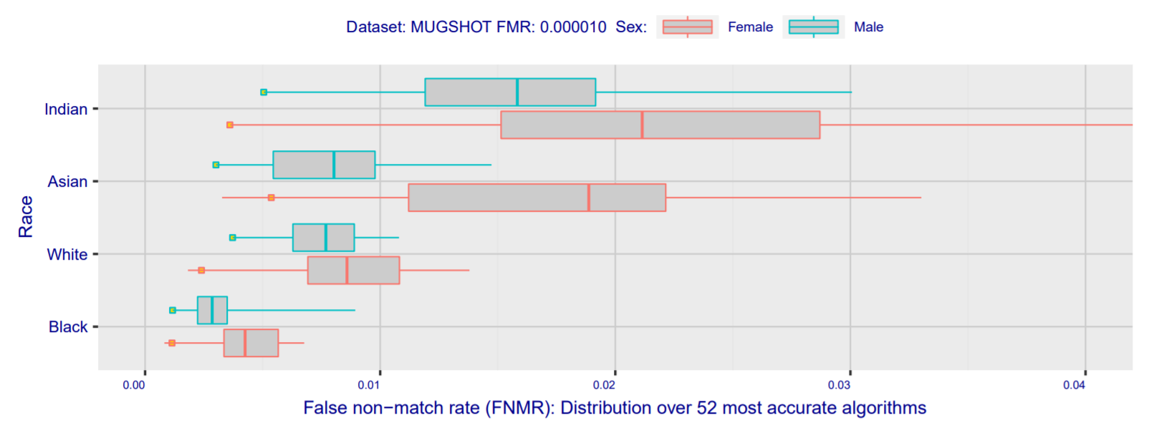
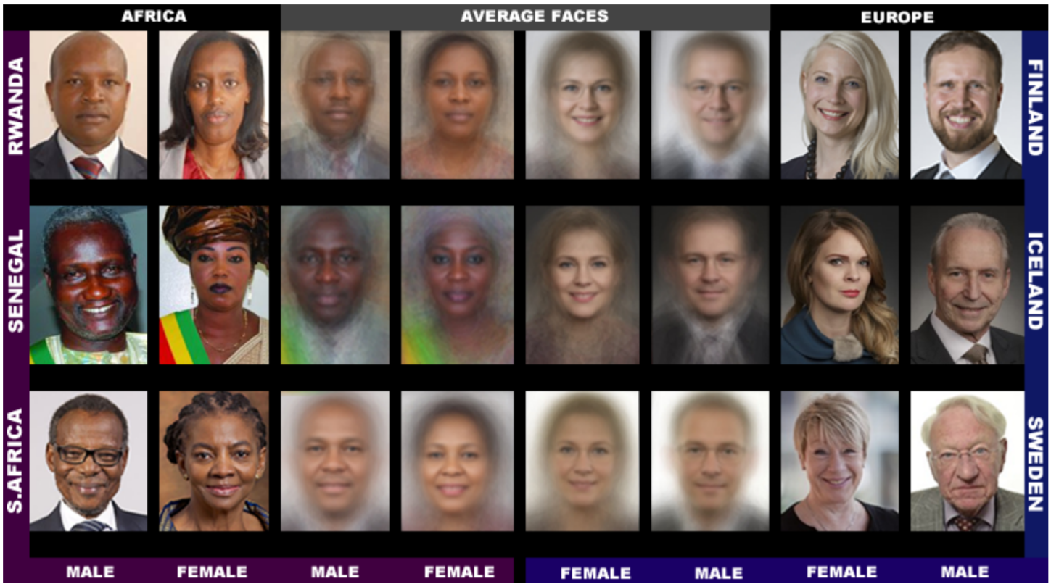
Bias in Facial Recognition Algorithms
Recent studies that test facial recognition algorithms have shown huge variation in performance. One found that many facial recognition algorithms are "10 to 100 times more likely to inaccurately identify a photograph of a black or East Asian face, compared with a white one". Even among the best algorithms there are notable differences in recognition performance across race and gender.
One factor that could lead to this difference is bias in the data used to train the algorithms. An analysis showed that two popular training sets were overwhelmingly composed of lighter-skinned subjects. This is supported by the above study, which showed that algorithms developed in Asian countries performed better on Asian faces.
Notes:
It's be nice to fit this in somewhere if there's time: https://www.youtube.com/watch?v=QxuyfWoVV98&feature=youtu.be

Slide 12
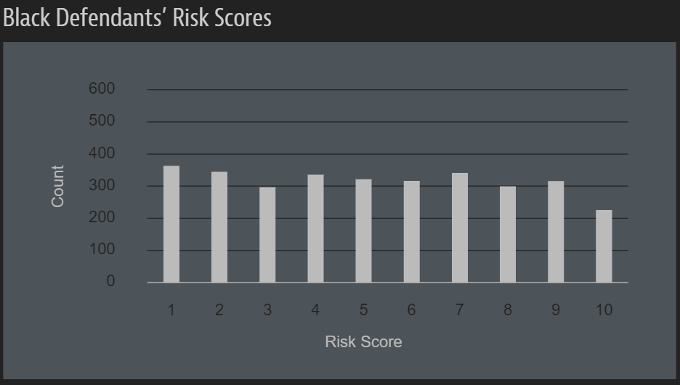
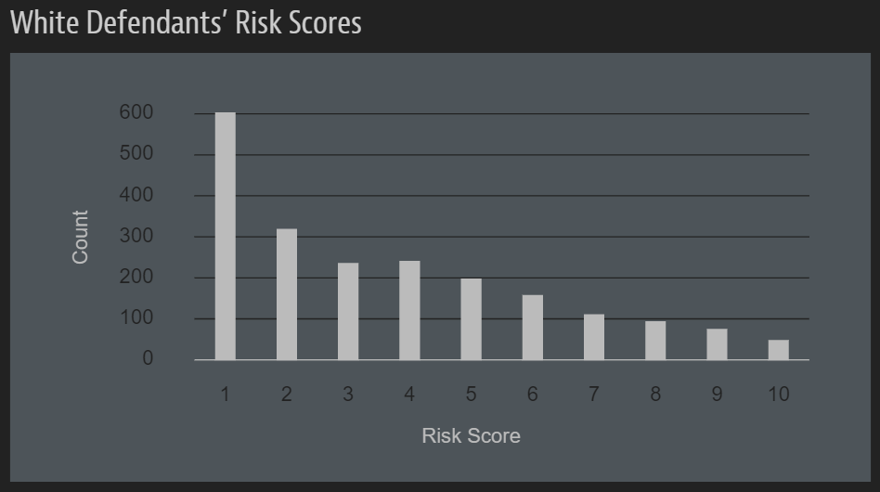
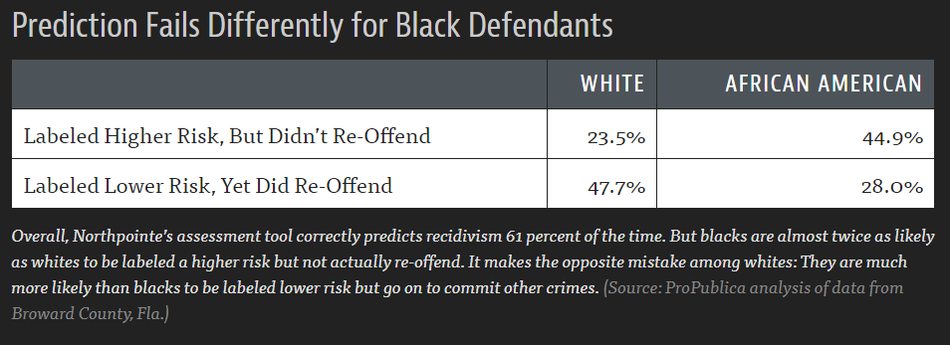
Bias in Other AI Algorithms
Sometimes, bias can also arise when the underlying distribution is skewed (in other words, systemic bias prevalent in a culture or society).
For example, bias has caused problems in algorithms for determining bail, which have shown bias in predicting a person's likelihood to commit future crimes based on race.
A similar problem was observed in an algorithm to hire engineers for Amazon, which showed bias towards hiring employees based on gender.

Slide 13
Misinformation
Questions about AI and responsibility extend to the algorithms social media networks use to decide which posts should be promoted. Studies have shown these algorithms can lead to the spread of false information.
Furthermore, a user may not even be aware of what data is being used to make a recommendation.

Slide 14
Responsibility and AI
It is important to consider all the ways in which a machine learning algorithm can make things easier for some while making things more difficult for others.
When algorithms affect certain communities disproportionately, those communities should be able to have a say in those decisions.
Reflecting on ethical responsibilities, remember to ask yourself: “What should we value broadly as a society? And what should we do to realize those values?”

Slide 15
AI Algorithm Design Activity

Slide 16
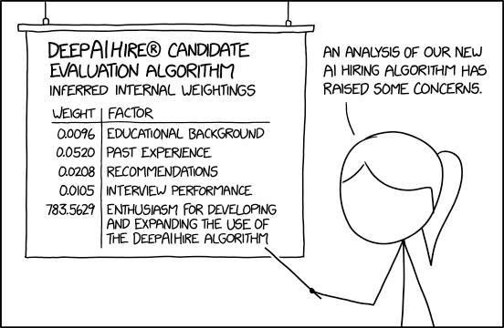
AI Algorithm Design Activity
Suppose that you are part of a team that is deciding whether to adopt an AI hiring algorithm for your company to choose potential job candidates.
What questions might you have for the designers?
What concerns might you have about the data used by the algorithm?
How will you ensure the adoption of the technology is not causing harm or reinforcing existing structural inequalities?

Slide 17
Learning Goals
Critically reflect on individual ethical concerns in relation to Computer Science
Highlight examples of ethics-related instances in the real world
Understand the significance of ethics from the perspective of your own academic disciplines and desired careers
Engage in discussions of ethical questions with peers

